Slide 1
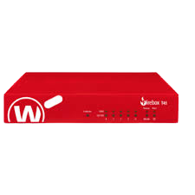
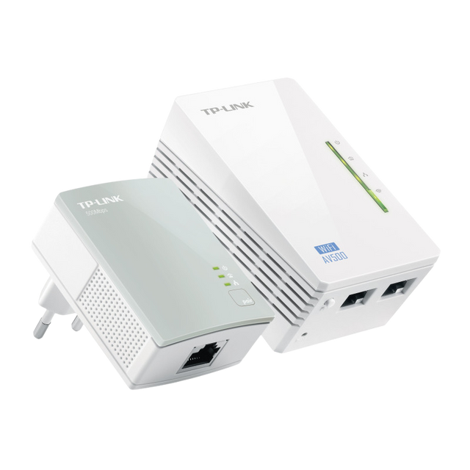
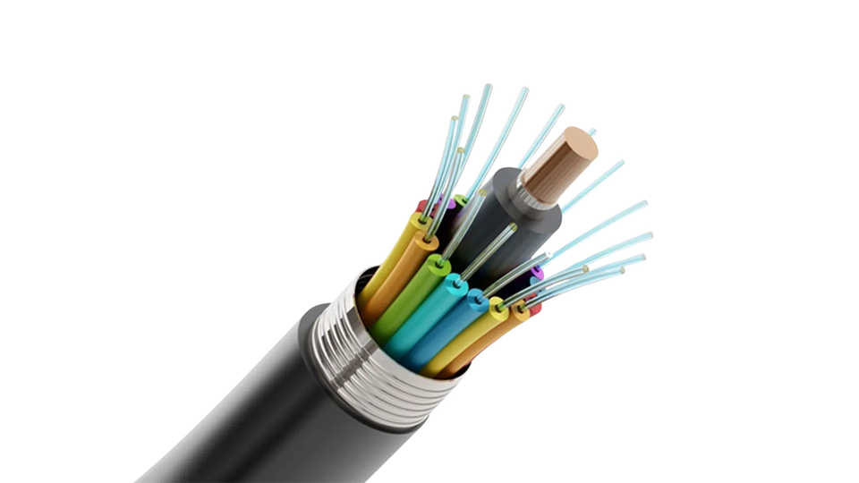
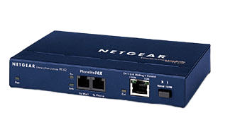
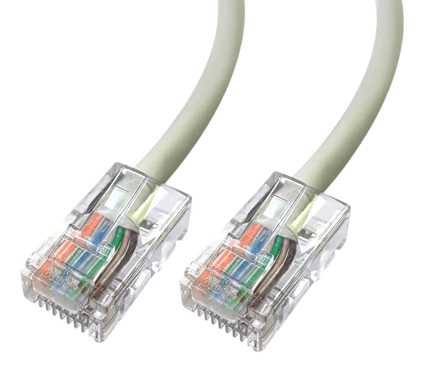

What are these objects?

Slide 2

Learning Objectives
Identify and explain the different types of networks
Compare wired vs wireless connectivity methods
Describe and evaluate different network topologies

Slide 3

What is a network?

Slide 4

What are the benefits of setting up a network?
Notes:
Benefits: resource sharing, communication, and collaboration, and can improve efficiency
and data access

Slide 5

What are the potential drawbacks of setting up a network?
Notes:
Drawbacks: security risks, costs of setup and maintenance, and potential network failures.

Slide 6

Networks use IP addresses and Mac addresses
What is an IP address?
What is a mac address?
Notes:
Drawbacks: security risks, costs of setup and maintenance, and potential network failures.

Slide 7

Different network types

Slide 8

Networks differ by.....
Number of users
Connection Media
Coverage Area

Slide 9
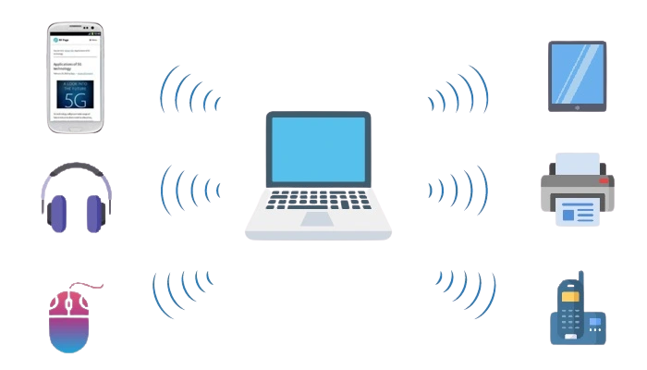
Personal Area Network (PAN)
Very small networks or connected devices within one building and used by an individual or small business. Limited distance accessibility

Slide 10

Local Area Network (LAN)
One of the most common and simplest types of network. Connects groups of devices across a short distance, either in the same building or buildings that are within close proximity to each other. Uses Wi-Fi/Ethernet (also known as WLAN if wireless)

Slide 11
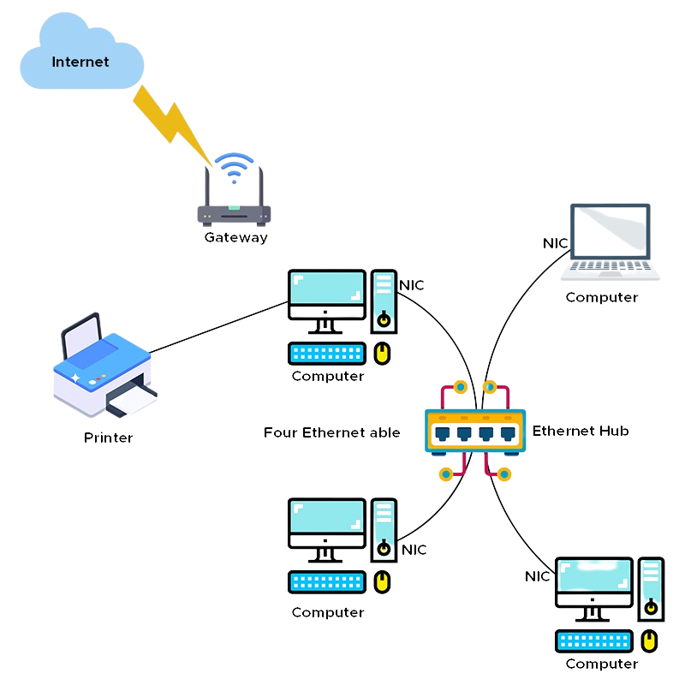
Notes:
Benefits - Convenient, Low Power
Cons- Short range, low speed

Slide 12

Wide Area Network (WAN)
Cover a wide area for communication between computers. The internet is an example of a WAN. May also be used to connect lots of LANS to a WAN, such as a head office and satellite offices around the country. Can be wired i.e. fibre, copper but also satellite

Slide 13
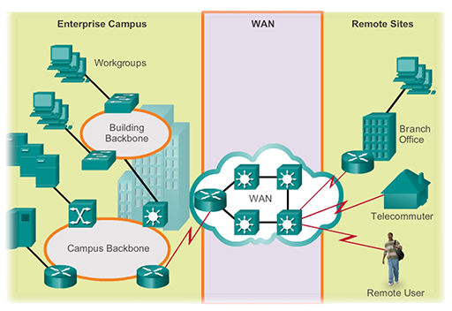
Notes:
Benefit: Enables global communication
Drawback: expensive infrastructure, latency, security risks

Slide 14

Metropolitan Area Network (MAN)
A network that bis bigger than LAN but smaller than WAN. Used to connect buildings together i.e. across a campus, city, geographical area. They usually use fibreoptics as a fast and reliable method of data transfer.
Notes:
Benefits: Connects nearby buildings/branches
Drawbacks: More costly and complex

Slide 15

Why might a MAN be more complex than a LAN?
Notes:
Benefits: Connects nearby buildings/branches
Drawbacks: More costly and complex

Slide 16

Virtual Private Network (VPN)
A secure connection to another network over the internet. This makes it possible to establish a private, safer and more secure network from a public internet connection, using encryption

Slide 17
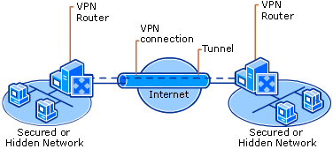
Notes:
Traffic sent over a secure connection to a private server. Creates a secure tunnel where traffic can go through
Benefit: Secure access from anywhere
Con: Needs configuration, can slow traffic down

Slide 18

Why might a company want users to use VPN’s when working from home?

Slide 19
Which network fits?
Office building of 200 staff
Bluetooth watch syncing to phone
University campus linking multiple sites
Remote worker connecting to a company server

Slide 20

Network Type
Coverage
Example
Benefit
Drawback

Slide 21
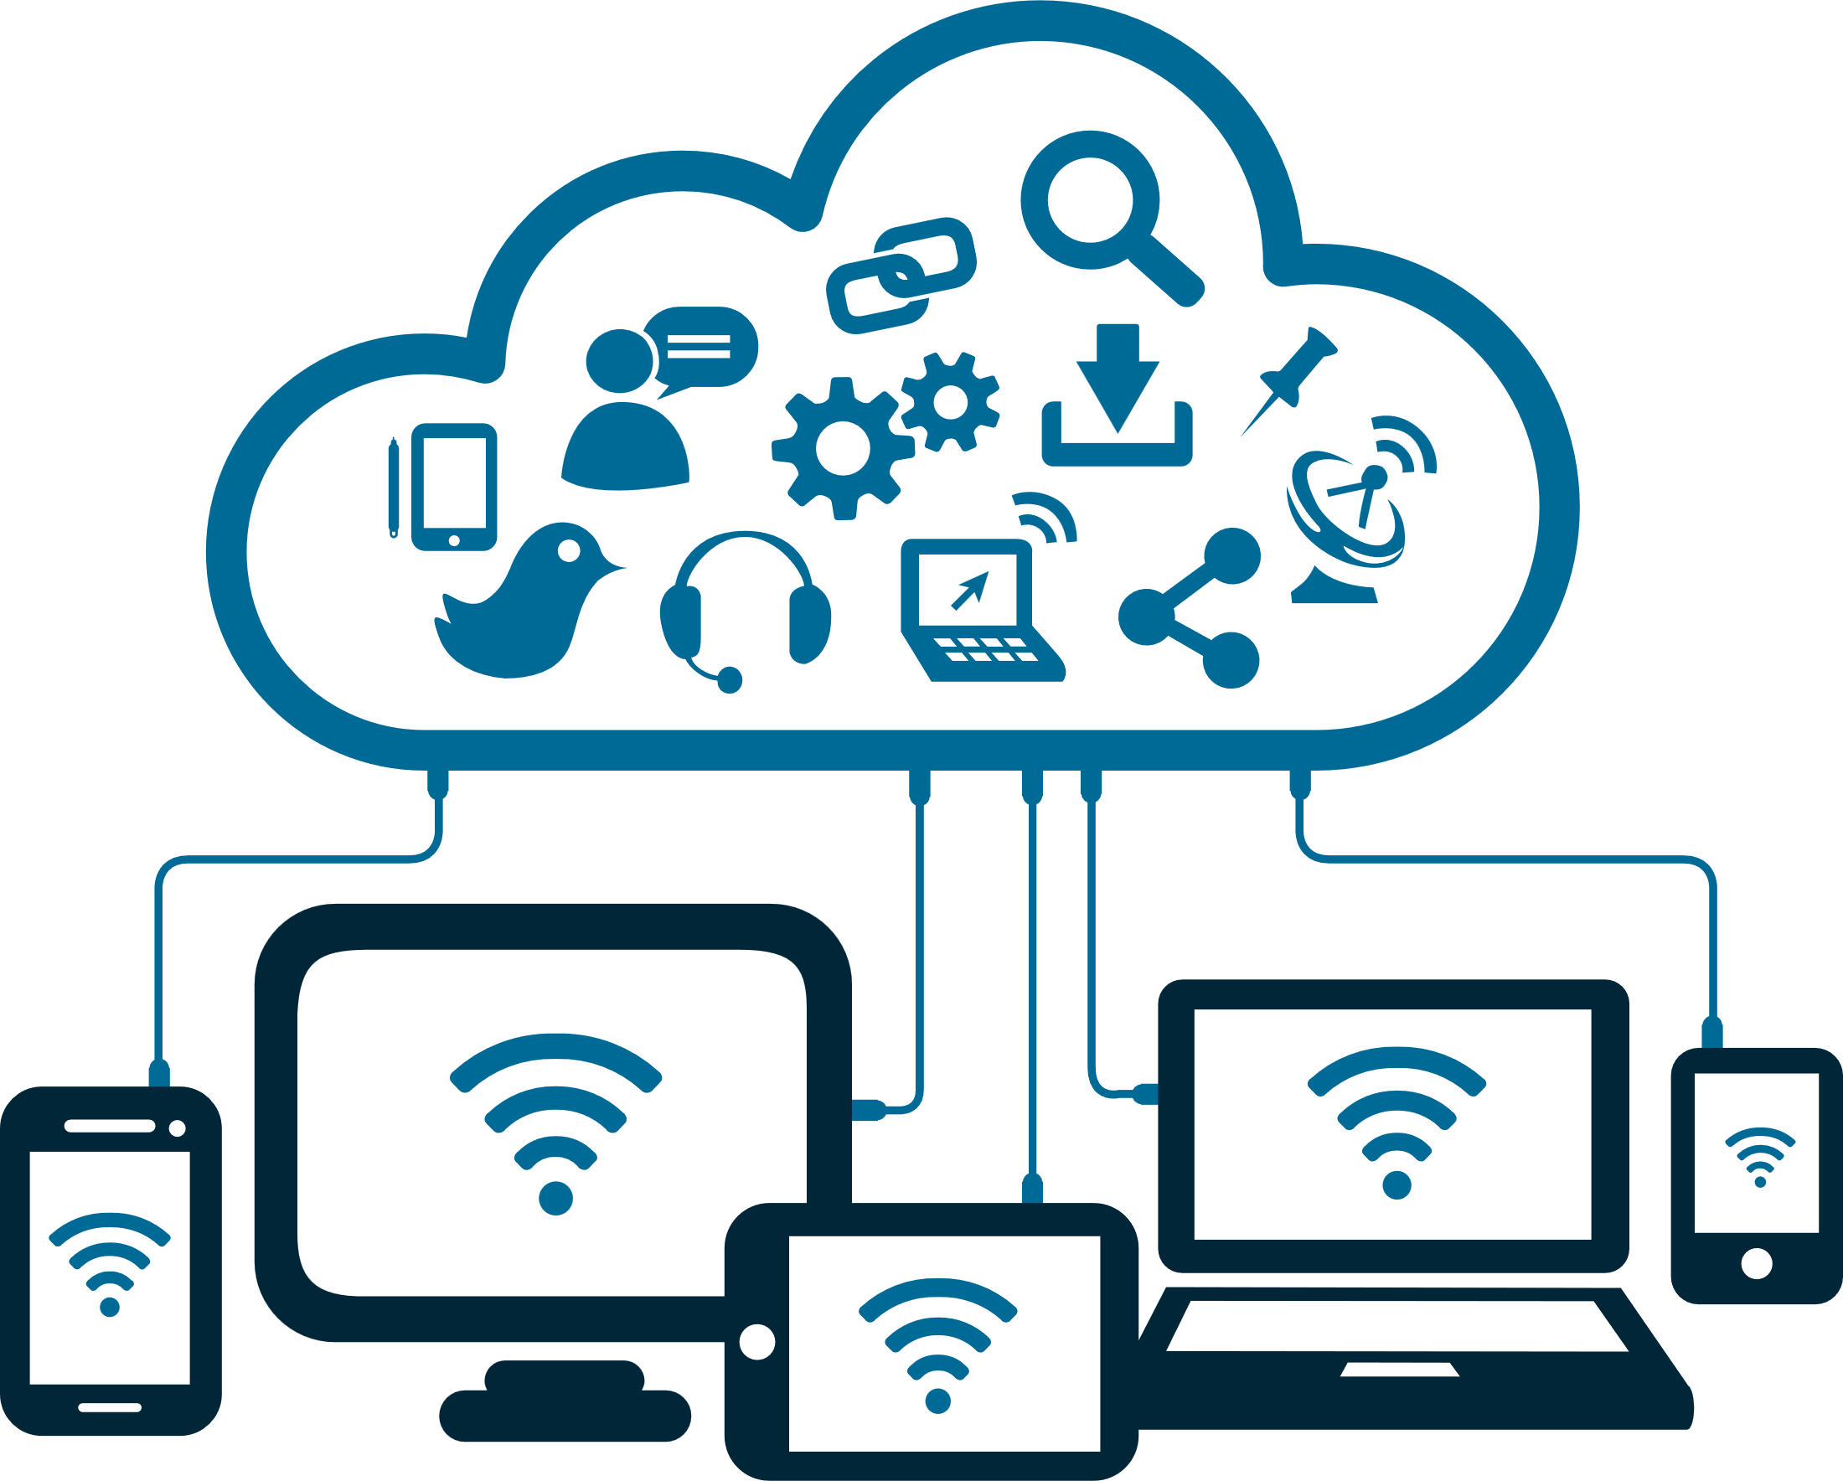
Connectivity Methods

Slide 22
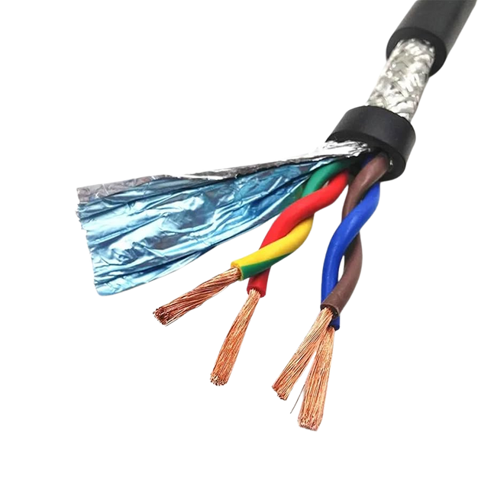

Copper/Ethernet
Transmits data and electricity using copper wires
Notes:
Coaxial
Twisted Pair
Pros: Flexible, Cost effective, Durable, More reliable
Cons: However prone to interference, slower than other methods

Slide 23
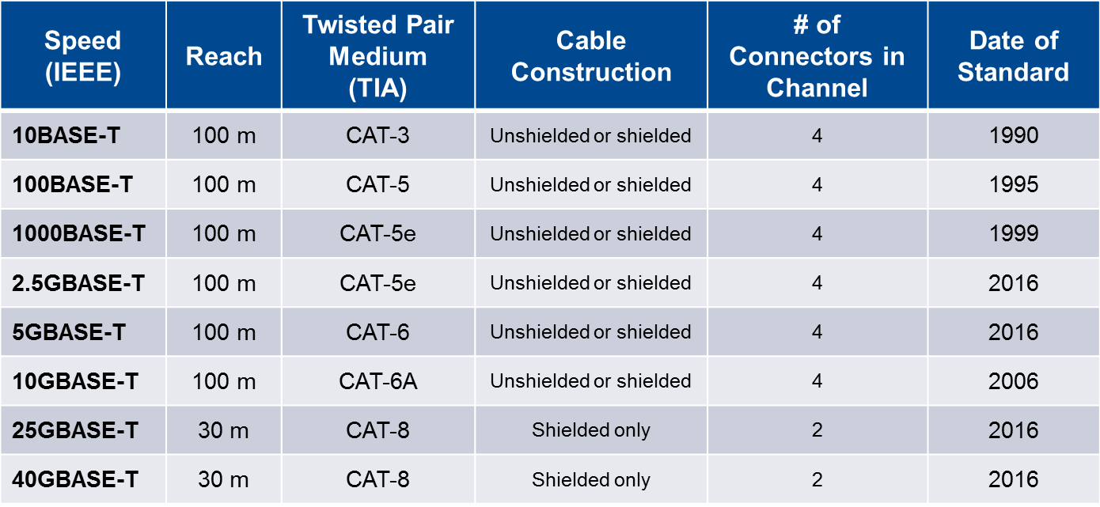

Slide 24
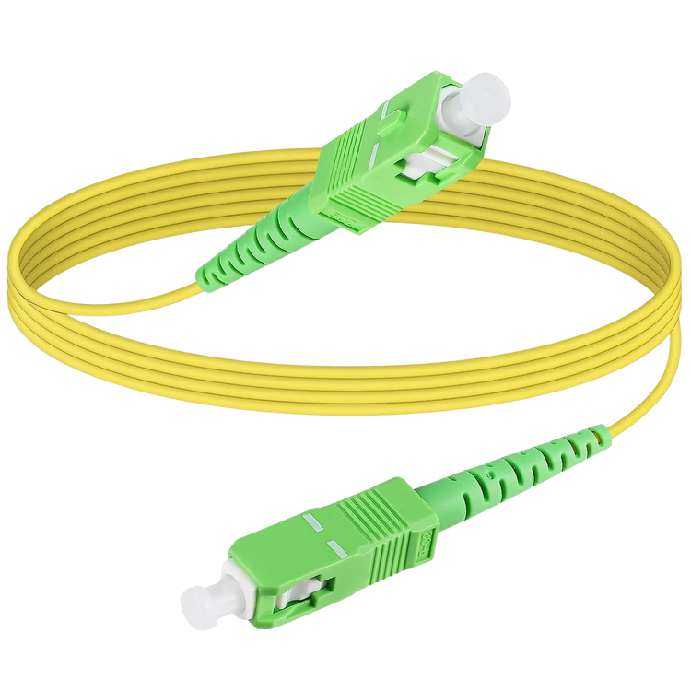
Fiber Optic
Fibre cable made of glass that users light to transmit data
Notes:
Single Mode - one path of light through a small core over long distances (expensive)
Multi Mode- multiple paths of light in larger core for shorter distances (cheaper)
Pros: Better data transfer, not prone to interference
Cons: Expensive, easy to break, lack of flexibility

Slide 25
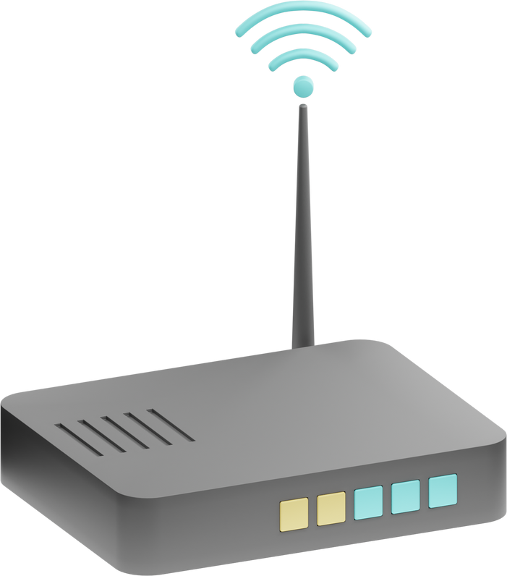
Wireless
Connects devices using radio waves instead of physical cables
Notes:
Pros: Offers flexibility, easy connection, cost effective, hackable
Cons: Limited range, slower speed, prone to interference, less mobility

Slide 26

Research the network topologies below
Star
Mesh
Tree
Bus
Include a diagram, pros, cons and examples where it may be used

Slide 27
Logical vs Physical
Physical Topology is the layout of devices on a network, in terms of physical structure. Logical is the way the data passed from one devices to another, linked to the protocols they use

Slide 28

VLANS
The method used to logically separate out networks

Slide 29

Why might we use VLANS?

Slide 30
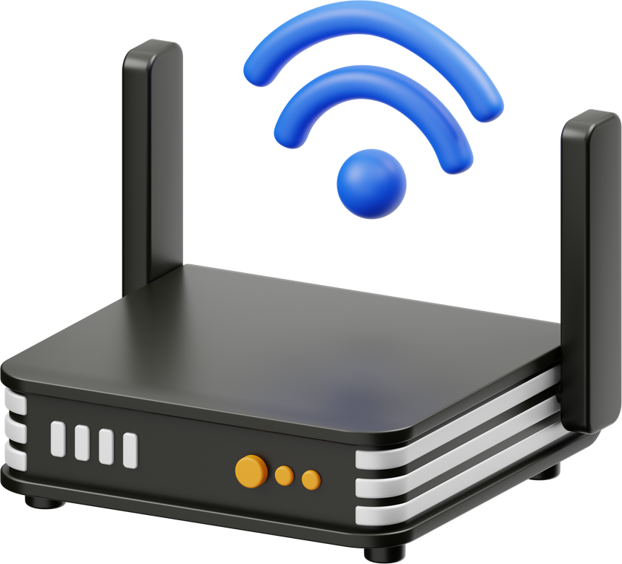
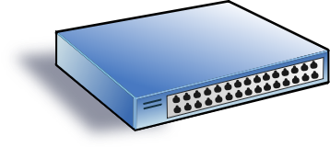
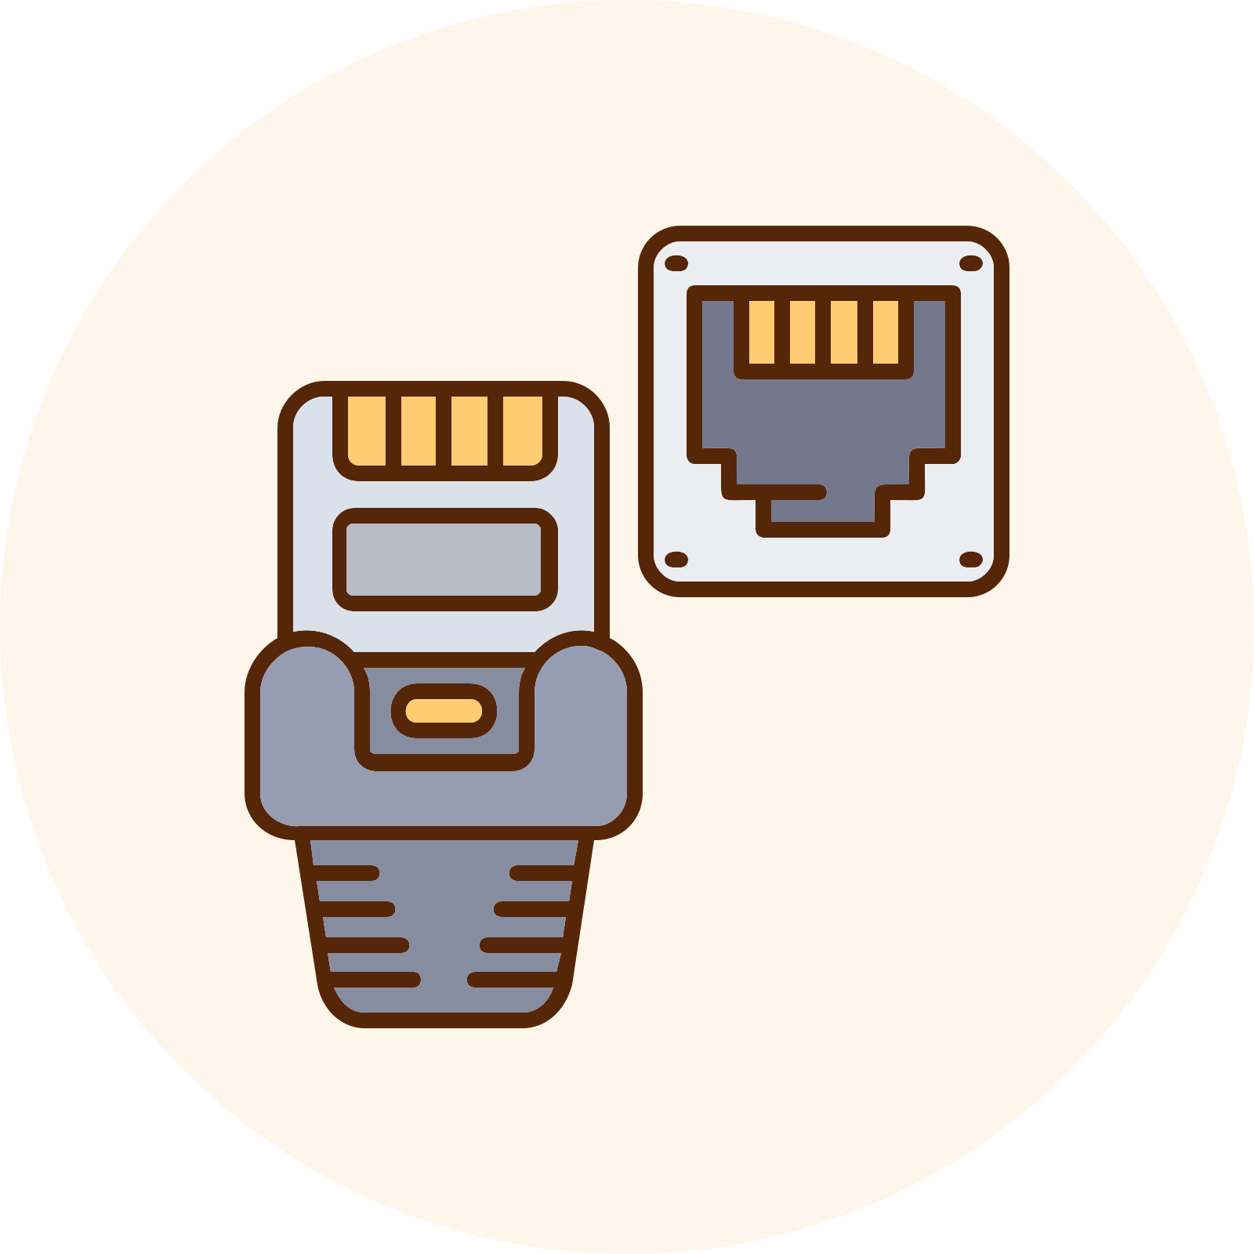

Network Components

Slide 31

Network Performance
What factors do you think could impact network performance?

Slide 32
Notes:
https://www.youtube.com/watch?v=E_9mlCpmnuk&t=42s

Slide 33

Research the three different network models. Write a small report on each type, providing pros, cons and examples of where they might be used
Client-Server
Peer to Peer
Thin Clients

Slide 34
A local graphic design company has 10 employees working in one office. They need to share printers, files, and internet access. Security is important as they handle client data.
What type of network should they use?
Should they use wired, wireless, or a mix?
Should they set up a client-server model or peer-to-peer?

Slide 35
A café wants to offer free Wi-Fi to customers. They don’t need customers to access staff computers or the till system, but the Wi-Fi should be fast and reliable.
What network type should they use?
Wired or wireless for customers?
How should they structure the network to keep staff and customers separate?

Slide 36
A family has several devices at home (PCs, tablets, gaming consoles, smart TVs). Their teenage child wants a lag-free gaming experience.
What network type (LAN/WAN)?
Which devices should be wired vs wireless?
Do they need a client-server setup, or will peer-to-peer be enough?

Slide 37
A construction company has a temporary site office in a rural location with no fixed internet lines. Staff need to communicate with head office, send reports, and hold video calls.
What network type would this be??
Would wired or wireless make more sense here?
What structure should they use for managing files and communication?

Slide 38
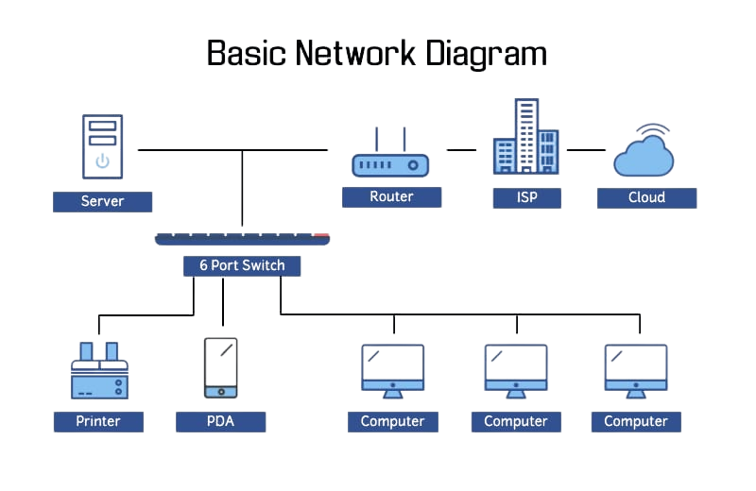
Use an online tool to draw a network map. This must include a router, a server, and a switch.

Slide 39
Wrap up
What is a PAN?
What’s one drawback of Wi-Fi?
What does latency mean?
Can you draw a star network?

Slide 40
Learning Objectives
Identify and explain the different types of networks
Compare wired vs wireless connectivity methods
Describe and evaluate different network topologies

Slide 41
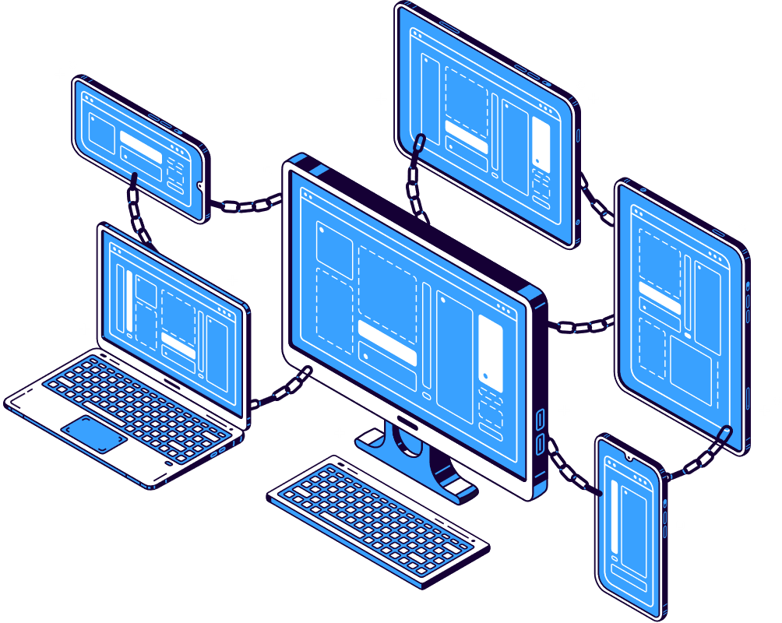
Flipped study
What is a software defined network?
Where are they used?
How will they change networking?

